Slide 1
4. Robot Force Control
4.1 The 1-DOF Force Control
4.2 The n-DOF Force Control
4.3 Impedance Control
4.4 Constrained Motion Control
- 1 -

Slide 2
4.3 Impedance Control
Rather than considering the motion and force problems separately, Impedance Control uses the concept that the controller should be used to regulate the dynamic behavior between the robot manipulator motion and the force exerted on the environment.
In impedance control, the control design specifies the desired dynamic behavior between the motion of the manipulator and the force exerted on the environment.
The desired dynamic behavior is referred to as the target impedance as it has a Ohm’law like relationship between motion and force.
- 2 -

Slide 3
4.3 Impedance Control
Using the common mechanical/electrical analogy that equates force with voltage and velocity with current, the ratio of force to velocity (similarly torque to angular velocity ) is referred to as the mechanical impedance.
In the frequency domain, this is represented as:
[c.f. Electrical Impedance (Ohm's Law)]
where is the environment force, is the velocity, and is the impedance.
- 3 -

Slide 4
4.3 Impedance Control
In terms of position , we may write as
For a linear case, the desired impedance of the environment might be specified as follows:
where constants M , B and K represent the desired inertia, damping and stiffness matrices, respectively.
- 4 -

Slide 5
4.3 Impedance Control
Combining the above two equations gives
which in the time domain is given by
Equation (5.11) specifies the desired response to achieve the target environmental impedance.
(5.11)
- 5 -

Slide 6
4.3 Impedance Control
For robot manipulators, the task of the impedance controller is to produce the actual response represented by
where x is the position and orientation of the robot end-effector, and x_{d} is the desired trajectory of end-effector
The impedance control strategy can be implemented using the task space formulation of the manipulator dynamics.
(5.12)
- 6 -

Slide 7
4.3 Impedance Control
Consider the robot dynamics equation formulated in the task space (constraint space)
where , and are the task space equivalence of the , and matrices in the joint space formulation, and
is the task space formulation of the joint space input torque.
- 7 -

Slide 8
4.3 Impedance Control
Using the partitioned control law formulation, we may choose the following model base part of the controller,
The servo (error driven) part is derived from the actual impedance formulation given in (5.12) as
From the task space force , the required torque input in the joint space is given by
- 8 -

Slide 9
4.3 Impedance Control
- 9 -

Slide 10
4.3 Impedance Control
Note that impedance control represents a unification of the various force control strategies.
The stiffness control strategy can be thought of as a special case of impedance control that consider only the steady state force/displacement relationship.
Note that an end-effector moving in free space exerts zero force on the environment for a given velocity and hence has zero impedance.
- 10 -

Slide 11
4.3 Impedance Control
While a manipulator rigidly attached to a wall is motionless for any applied force and hence has infinite impedance.
Pure position control can be considered as impedance control with zero impedance and pure force control can
be considered as impedance control with infinite impedance.
Practical implementation consideration:
Impedance control is a Cartesian formulation and hence is rather computation intensive. In addition, problem of singularities (J matrix singular) may also appear.
- 11 -

Slide 12
Tutorial Example
Two-link manipulator the sinusoidal trajectory, and the external environment model is represented by a spring model.
Consider two-link manipulator described by
where
- 12 -

Slide 13
Tutorial Example
Consider the robot dynamics equation formulated in the task space
where
is the force of the external environment on the end of the robot
The required torque input in the joint space is given by
- 13 -

Slide 14
Tutorial Example
Assuming the external environment model is represented by a spring model.
Impedance control parameter
The desired trajectory：
Assuming the parameters vector
- 14 -

Slide 15
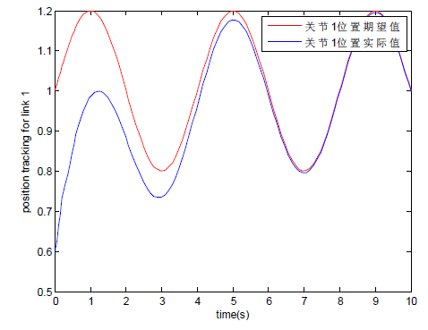
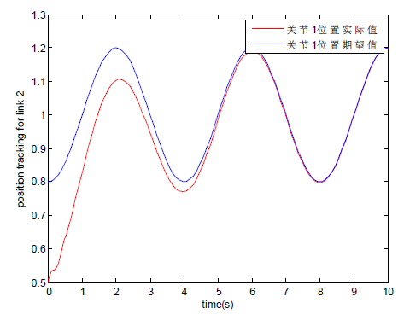
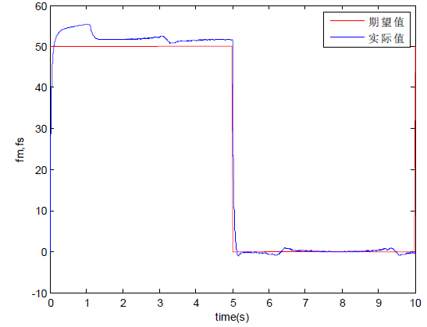
Tutorial Example
Desired joint 1
Actual joint 1
Desired joint 2
Actual joint 2
Desired
Actual
The tracking effect of joint 1
The tracking effect of joint 2
The external force at the end of the manipulator

